Slide 1
NORTHSTAR INTELLIGENCE PLATFORM
ETL Operations
Visual logic & calculations
The reports answer questions about the portfolio. This one answers questions
about the platform that produces them.
/api/dashboard · captured 01 August 2026

Slide 2
The shell
One route, five renderers
Server-rendered HTML. No client framework, and no build step to go stale.
A ?tab= parameter picks the renderer. Anything unrecognised returns the list of valid tabs rather than a 500, which matters more than it sounds — a typo in a bookmarked link should not look like an outage.
Navigation state living in the URL means any tab can be linked, bookmarked, or pasted into a thread mid-investigation. That was the whole reason for the parameter.
The alert banner is rendered by the shell, not by any tab, so a problem found on one screen stays visible on all of them. At capture time: 10 open high-severity actions, and 2 days missing from bronze in the last 7.

Slide 3
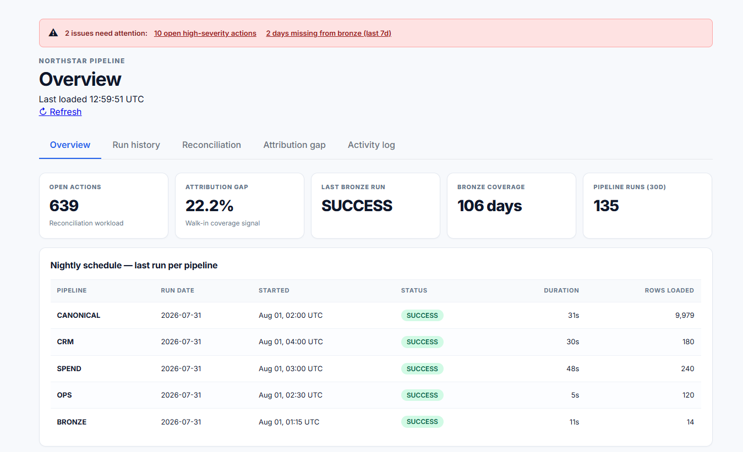
1 · Overview
Did it run last night, and is anything piling up?
LAST RUN PER PIPELINE
SELECT PipelineKey,
MAX(RunId) AS LatestRunId
FROM pipeline.pipeline_runs
GROUP BY PipelineKey
Not a TOP 6 — that returns six runs of the busiest pipeline.
Why grouped, not ranked
Grouping by pipeline guarantees every pipeline gets a row, whether it ran last night or last week.
A stale date is how an absence becomes visible. Rank by recency instead and a silent failure renders as nothing at all, which is the failure mode this panel exists to prevent.

Slide 4
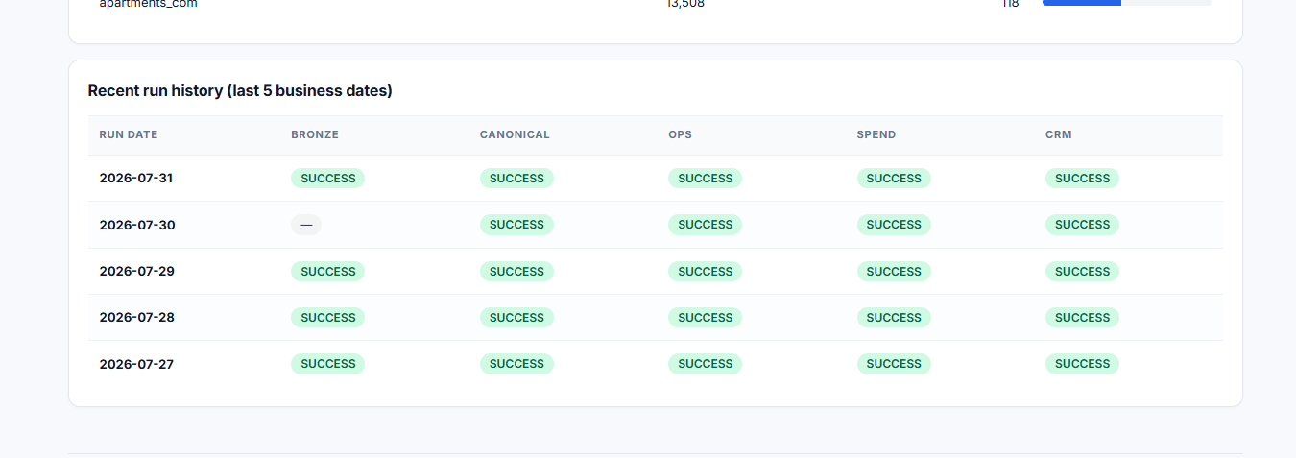
1 · Overview, continued
The four panels beneath the fold
What each one is for
—
The throughput trend is log scale. Canonical writes ~9,979 rows a night and bronze writes 14; on a linear axis four of the five pipelines flatline against the baseline.
—
A gap in that line means a night with no successful run. Absence is drawn, not omitted.
—
Reconciliation actions are grouped by type with high severity split out beside the total. SPEND_DIVERGENCE_UNRESOLVED carries 56,640 actions and none of them high; MISSING_FOLDER carries six, all six high. One column would have hidden both facts.
—
Top divergent vendors ranks by action count and days affected together, so a vendor that diverges badly once ranks below one that diverges mildly every day.
The cross-tab reads down for pipeline reliability, across for a bad night.

Slide 5
1 · Overview — the run history cross-tab
Five business dates against five pipelines
2026-07-30, AS RENDERED
The case that matters
BRONZE —
CANONICAL SUCCESS
OPS SUCCESS
SPEND SUCCESS
CRM SUCCESS
Four pipelines succeeded that night, and all four read bronze. So bronze produced its files and failed only to record that it had.
A missing row and a missing night render identically here. That is a known gap, not a design choice.
An em dash means no row in pipeline_runs. It does not mean a failure.
Reading down a column tells you whether one pipeline is unreliable. Reading across a row tells you whether one night failed broadly. A flat list supports neither, which is the only reason this panel is a matrix.

Slide 6
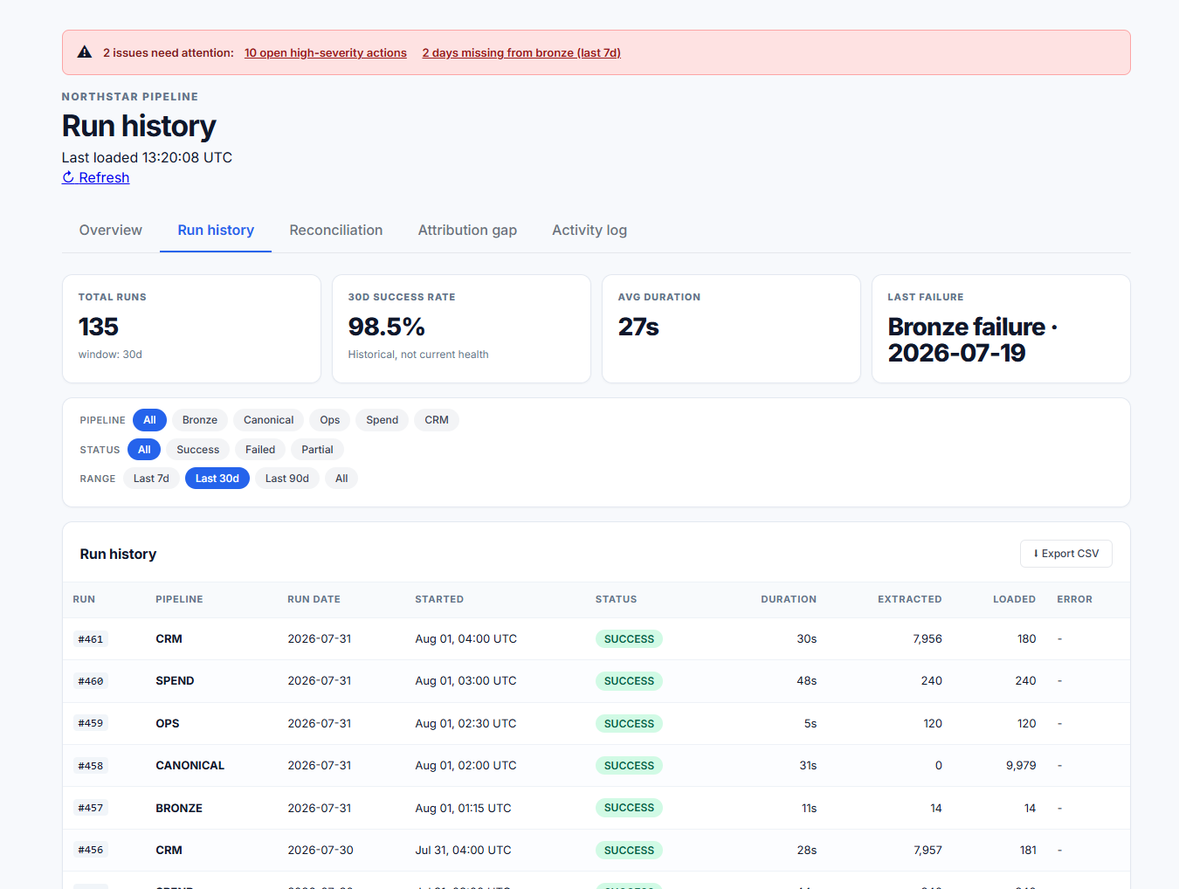
2 · Run history
The execution ledger
STATUS VOCABULARY
SUCCESS completed, rows written
FAILED crashed or threw
RUNNING started, no end recorded
ROW_COUNT_MISMATCH wrote, did not reconcile
135 runs · 98.5% over 30d · 27s average.
Rows loaded sits beside status on purpose
A run can finish SUCCESS having written nothing.
This platform carried exactly that defect until the publisher was changed to fail on a zero-row write. Putting the count next to the status is the cheap version of that guard, and it stays useful even now the expensive one exists.

Slide 7
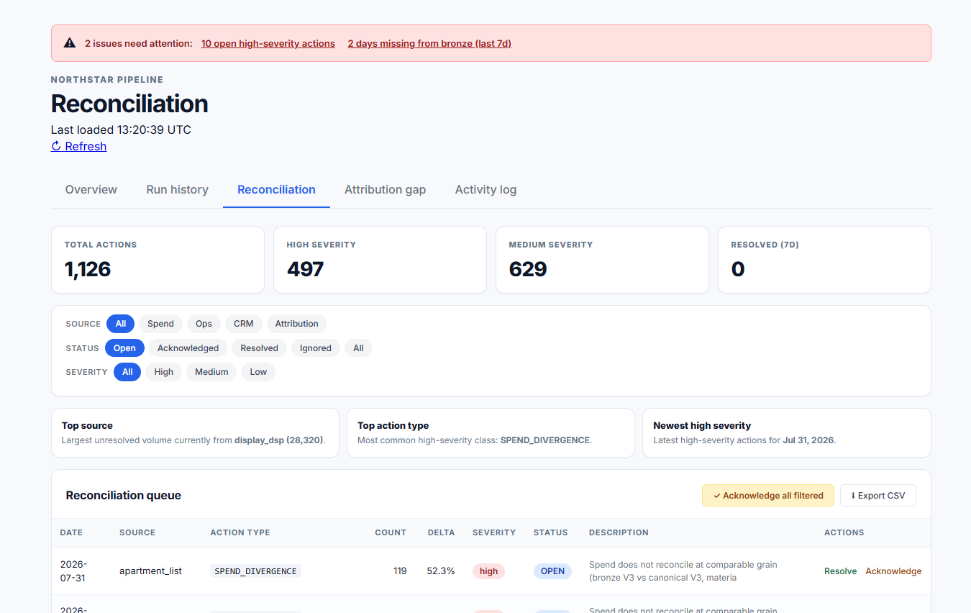
3 · Reconciliation
The only tab that is a workflow rather than a report
Bulk applies to the filter
Source, status and severity compose. Chips rather than dropdowns, so the current filter is always on screen.
1,126 actions. 639 open, 497 high, 629 medium.
Acknowledging all filtered acts on every matching row, not the 25 on screen. Working a queue of 639 a page at a time is not work anyone does twice.
The narrowing is the safeguard. You have to reduce the set before you can clear it, and that act is what stops you clearing too much.

Slide 8
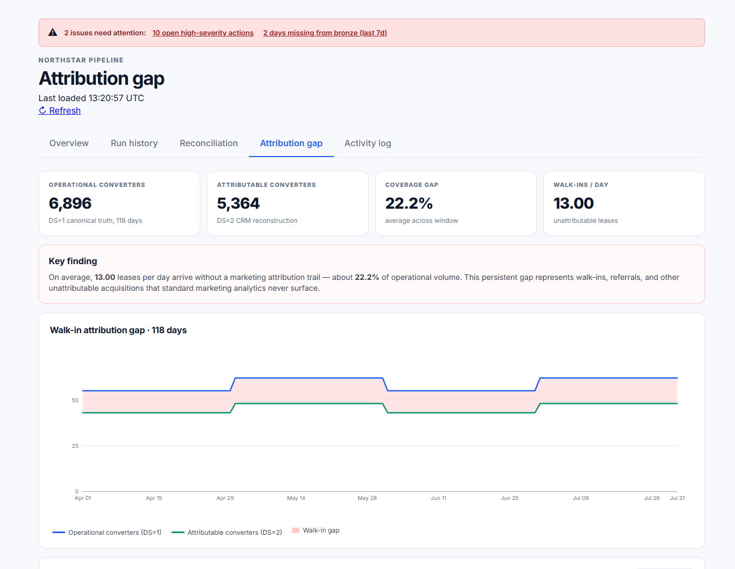
4 · Attribution gap
Leases that happened, with no marketing trail behind them
THE SUBTRACTION
operational (DS=1) 6,896 canonical truth
attributable (DS=2) 5,364 CRM rebuild
──────
walk-in gap 1,532 22.2%
About 13 leases a day arriving with no attributable path.
Most analytics cannot do this
A real operator holds only the CRM view, so they cannot see what it is missing.
Holding canonical truth beside the reconstruction is what makes the difference computable at all.
A wide gap is walk-ins and referrals behaving normally. It is not a data quality failure, and reading it as one would be the expensive mistake.

Slide 9
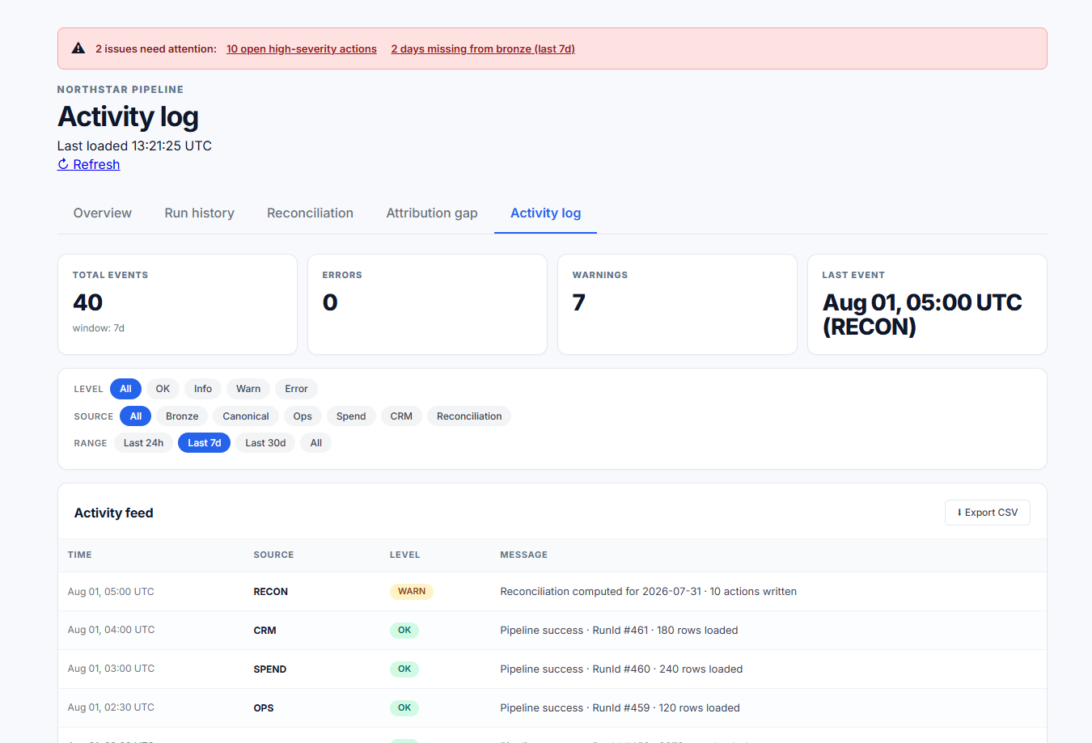
5 · Activity log
Every pipeline's events, unioned into one chronological feed
ONE CTE, FOUR CONSUMERS
unioned events → total 40
→ errors 0
→ warnings 7
→ the feed
Same filter clause on each, so the strip and the table cannot disagree.
Unified, not linked
Diagnosis is chronological. When a night goes wrong the question is what happened, in order, and the answer spans pipelines.
Per-pipeline logs make the reader interleave timestamps by hand. That is the work this feed removes.

Slide 10
What the dashboard is for
Six behaviours, each built so nothing missing looks like nothing wrong
01
02
03
Freshness before detail
Absence occupies a row
Success is verified
The first thing on screen is when the platform last ran
Grouping by pipeline means a silent failure renders as a stale date rather than as blank space. It is the single most important query decision on the Overview tab
Row counts sit beside status, so a run that wrote nothing cannot pass for a healthy one
04
05
06
Disagreement is queued
The queue stays workable
The unmeasurable is measured
Conflicts become actions with a type, a severity and an owner. Nothing is averaged away
Filters compose and bulk resolution follows them, which is what keeps 639 open actions usable
Canonical truth beside the CRM reconstruction turns the walk-in gap into a number
The reports answer questions about the portfolio. This answers questions about the platform that produces them.

Slide 11
NORTHSTAR INTELLIGENCE PLATFORM
A report on stale data
is worse than one that fails.
ETL Operations Dashboard · Visual logic & calculations

